Slide 1
HR Attrition Analysis (Project By: Arti Yadav)
www.linkedin.com/in/arti-yadav-428b11229
https://drive.google.com/file/d/1gVYRxEFFhIBfih1kaBj4BmGK-dtSBYAC/view?usp=drive_link

Slide 2
Introduction
Attrition/Churn/Turnover Rate refers to the rate at which employees leave a company. Employee turnover is a costly problem for organizations.
The cost of replacing an employee can be quite large, and a study found that companies typically pay about one-fifth of an employee's salary to replace them.
The cost can significantly increase if executives or highest-paid employees are to be replaced. The cost of replacing employees for most employers remains significant.
This is due to the amount of time spent to interview and find a replacement, sign-on bonuses, and the loss of productivity for several months while the new employee gets accustomed to the new role.

Slide 3
Purpose:
In this project we are going to develop a model that could predict which employees are more likely to quit. We are going to explore the data and then create a model to predict how likely the employee quit the job.

Slide 4
Project Structure:
Data Exploration
Data Preprocessing
Exploratory Data Analysis (EDA) - Pandas/Numpy
Data Modification
Data Visualization - Seaborn
Feature Selection
Model Selection and Training
Model Evaluation using ML Algorithms for Attrition Prediction
Classification Report and Accuracy Explanation

Slide 5
Variable Discription
Sr No. | Variable Name | Variable Definition
1 | Age | Age of the employee
2 | Attrition | Employee who stayed -0 , Employee who leave- 1
3 | BusinessTravel | Traveling frquency
4 | DailyRate | Daily Rate of Employee
5 | Department | Departments existing in the company
6 | DistanceFromHome | Distance from home and workplace
7 | Education | 1-Below College, 2-College, 3-Bachelor, 4-Master, 5-Doctor
8 | EmployeeCount | The count of employee
9 | EmployeeNumber | The number assigned to employee
10 | EducationField | Life Sciences,Other, Medical, Marketing, Technical Degree, Human Resources
11 | EnvironmentSatisfaction | 1: Low, 2 :Medium, 3 :High, 4 :Very High
12 | Gender | Female or Male
13 | HourlyRate | Hourly Rate of Employee
14 | JobInvolvement | 1: Low, 2 :Medium, 3 :High, 4 :Very High
15 | JobLevel | Job levels in the company

Slide 6
Sr no. | Variable Name | Variable Definition
16 | JobRole | Job Role of the employee
17 | JobSatisfaction | 1: Low, 2 :Medium, 3 :High, 4 :Very High
18 | MaritalStatus | Maritial status of the employee
19 | MonthlyIncome | Monthly income of the employee
20 | MonthlyRate | Monthly rate of the employee
21 | NumCompaniesWorked | No.of Companies before the current one
22 | Over18 | Employee over 18 years or not
23 | OverTime | Worked over time or not
24 | PercentSalaryHike | Percentage of Salary increase between %11-%25
25 | PerformanceRating | 1 :Low, 2 :Good, 3 :Excellent, 4 :Outstanding
26 | RelationshipSatisfaction | 1: Low, 2 :Medium, 3 :High, 4 :Very High
27 | StandardHours | standard work hour for each employee: 80 Hours
28 | StockOptionLevel | Indicate the stock level of employee
29 | TotalWorkingYears | Employee`s total working years
30 | TrainingTimesLastYear | Employee`s training period in the last year
31 | WorkLifeBalance | 1 :Bad, 2 :Good, 3 :Better, 4 :Best
32 | YearsAtCompany | Employee`s total working year at the company
33 | YearsInCurrentRole | Employee`s current position at the company in years
34 | YearsSinceLastPromotion | Last promotion year of the employee
35 | YearsWithCurrManager | Employee working with the current manager in years

Slide 7
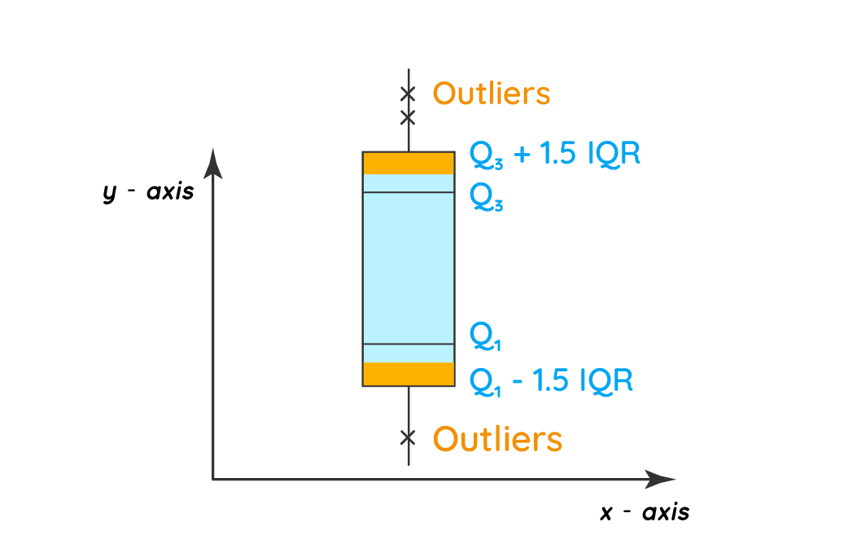
Exploratory Data Analysis:
Lets Start With Outliers:
Outliers are extreme values that differ from most other data points in a dataset. They can have a big impact on your statistical analysis.
It’s important to carefully identify potential outliers in your dataset and deal with them in an appropriate manner for accurate results.

Slide 8
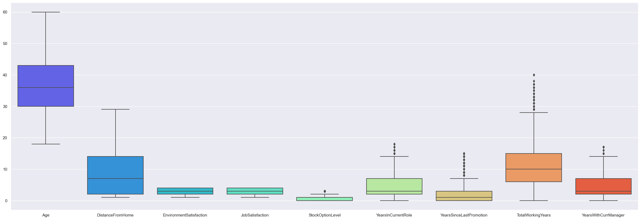
From above boxplot we can find out:
* We can see the five point summary of the each attributes i.e. minimum, first quartile [Q1], median, third quartile [Q3] and maximum.
* We can see, there are outliers present 'YearsInCurrentRole', 'YearsSinceLastPromotion', 'TotalWorkingYears', 'YearsWithCurrManager' columns. But it will not affect our analysis as it is very less.
* It suggest that few employees are working in current role and with the same manager for more than 15 years also few employees have not got any promotion from 8 years. It can be the reason for increase in rate of attrition.

Slide 9
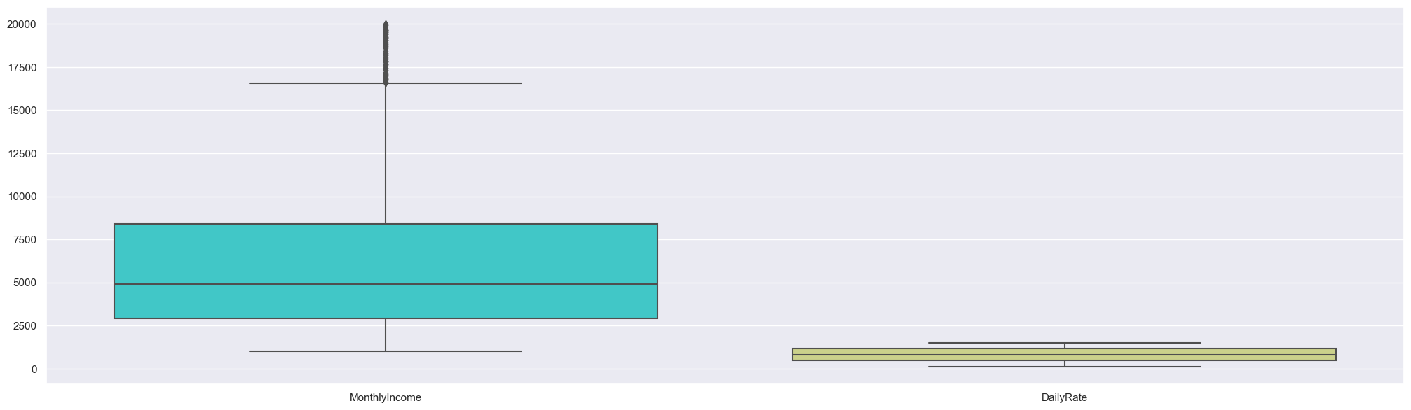
* In MonthlyIncome we see that there are few employees who are getting more than maximum salary offered. We can also see that avg salary range is 5000. There are no outliers for DailyRate.
We can ignore this outliers as it will not affect our analysis and prediction.

Slide 10
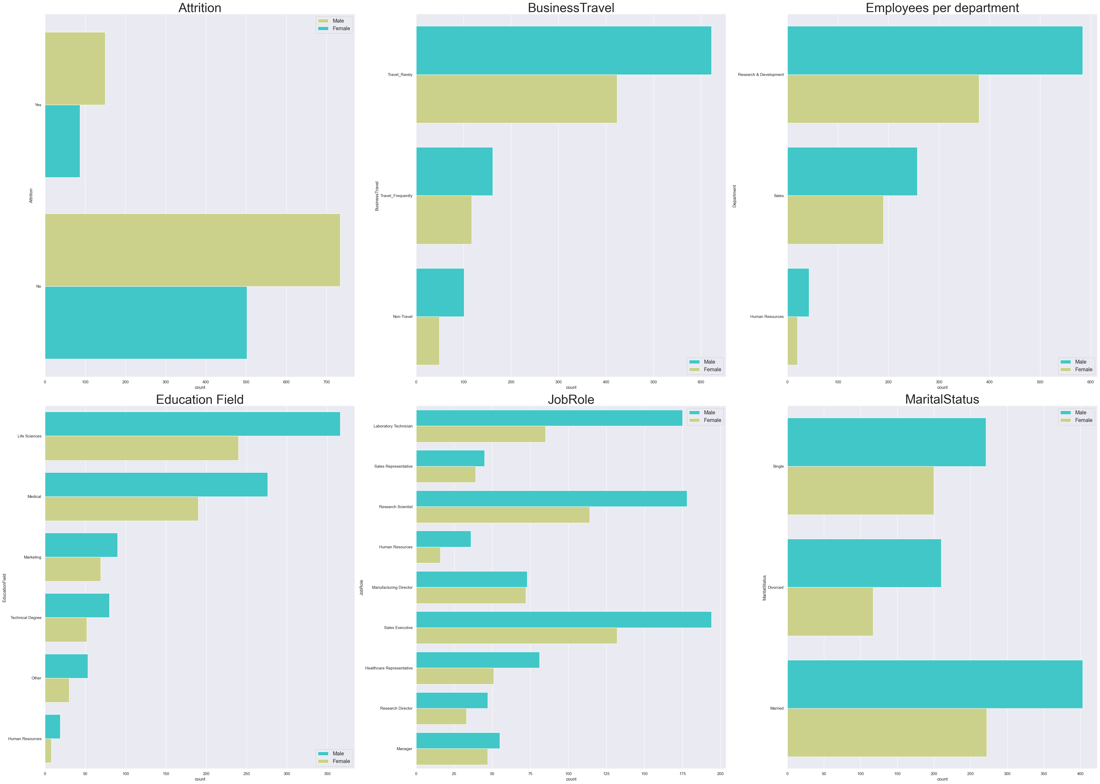
Gender Wise Exploration of Categorical Features
From this countplot we can observe:
* We can see Gender-wise countplot data for all the categorical columns.
* We can get Idea various categorical sub-values and their frequency with reference to Gender of employees.
* Attrition rate is greater in Male than Female employees.
We can also see that males are leading in every countplot which suggest that female employees are struggling or lagging behind somewhat in the corporate world.

Slide 11
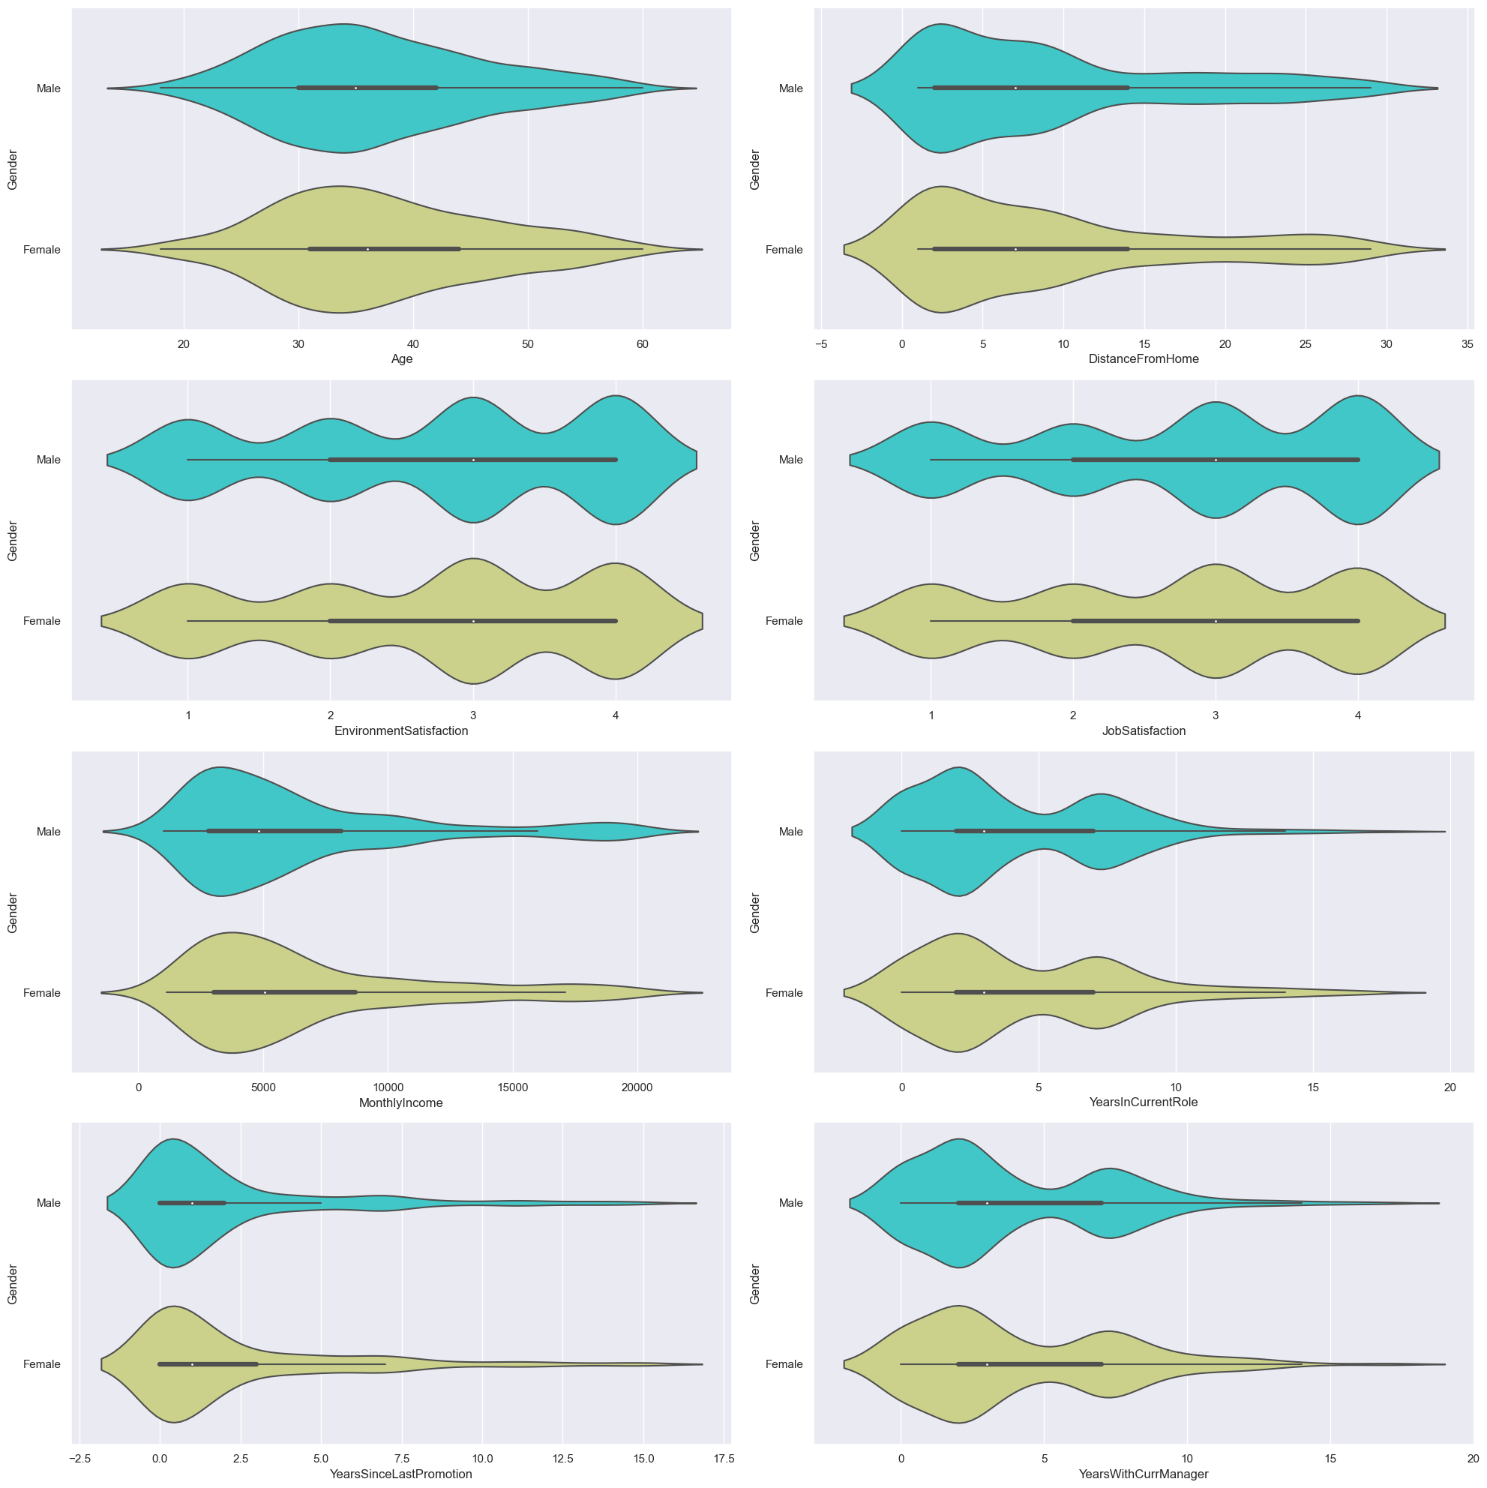
Gender Wise Exploration of Numerical Features
From above plots we can easily see the distribution of various numerical attributes within the ranges.
Volinplot is easy to interpret and to get insights from numerical columns. It can also detect any outliers present in Data Set.
We can observe:
* For all attributes for both Genders distribution is mostly even.
* Avg Age of emplyees lies between 30-40 years. Distance from home for the most of the employees lies within 2-10 KMs.
* We can see the distribution of monthly income lies between 2500-5000
* Similary we can interpret the plot for other attributes present.

Slide 12
Correlation
Correlation analysis is a statistical method used to evaluate the strength and direction of the relationship between two or more variables. The correlation coefficient ranges from -1 to 1.
A correlation coefficient of 1 indicates a perfect positive correlation. This means that as one variable increases, the other variable also increases.
A correlation coefficient of -1 indicates a perfect negative correlation. This means that as one variable increases, the other variable decreases.
A correlation coefficient of 0 means that there’s no linear relationship between the two variables.

Slide 13
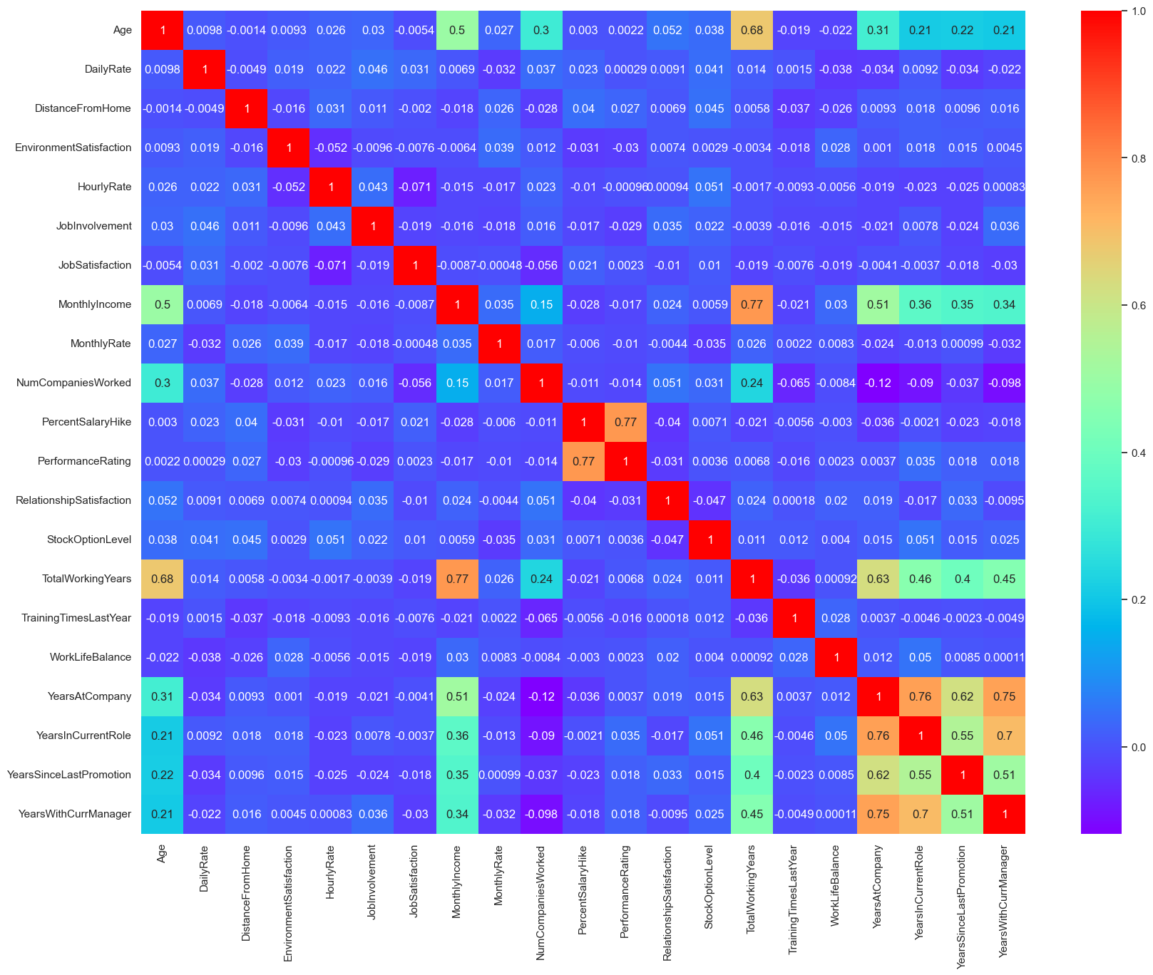

Slide 14
Few key Learnings from the correlation visualisation (heatmap) :
Age has a 68% correlation with total working years, which means that as we continue to work at an organization, we tend to get older, which is a logical conclusion.
Monthly income has a 77% correlation with total working years. It indicates as we work longer, we are likely to receive higher salaries.

Slide 15
Machine Learning Models Summary :
We developed few models :
1-Random Forest [achieved an accuracy of 87%(With variance)]
2-Random Forest-post prunning [achieved an accuracy of 86%]
3-Logistic Regression [achieved an accuracy of 89%]
4-PCA-Logit [achieved an accuracy of 82%]
5-PCA-Random Forest [achieved an accuracy of 85%(With variance)]
6-Decision Tree [achieved an accuracy of 77-78%(With variance)]
7-Decision Tree-post prunning [achieved an accuracy of 87%]
These models indicating that 'Logistic regression' & 'Random Forest post prunning' and 'Decision Tree post prunning' model has good predictive power.
Let’s See the Important Features predicted by these models….

Slide 16
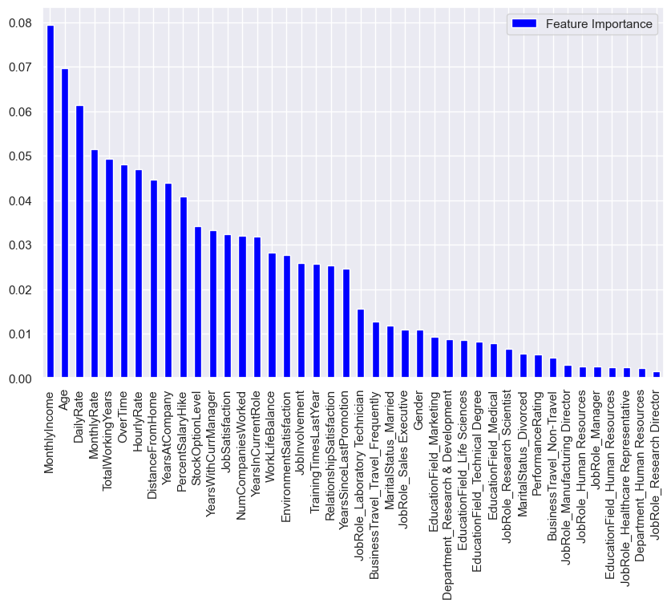
Monthly income appears to be the most important feature followed by the persons age, daily rate, and Monthly rate. Seeing this result we can say that people with a higher income are less likely to leave than someone with a lower income.

Slide 17
Conclusion & Key Points:
Based on our analysis of the HR Analytics Employee Attrition & Performance dataset, we can draw the following conclusions:
The developed model achieved an accuracy of 87%, indicating that it has good predictive power.
Factors such as job level, monthly income, and age were found to be important predictors of employee attrition.
The company can use the model to identify employees who are at high risk of leaving and take proactive measures to retain them.
Possible strategies for improving employee retention include offering competitive compensation and benefits packages, providing opportunities for career growth and development, and providing a positive work environment.
Overall, our analysis highlights the importance of leveraging HR analytics to gain insights into workforce trends and patterns, and ultimately to make strategic decisions that can improve employee retention and reduce the costs associated with employee turnover.

Slide 18

Thank You…..

